Slide 1
Project Proposal: Bannanalyzer
Neil Ross Daniel
221270

Slide 2
Value proposition
Business Understanding Components
Try to convey as much of the following requirements on the AI Canvas on the next slide as possible.
Use separate slides to:
Conduct market research & target audience analysis
Argue for proposal feasibility
ILO Mapping: POOR, INSUFFICIENT
Business Understanding Requirements:
Conduct research into overall consumer market ( User case 1);
Based on the conducted research generate an idea for an overall consumer market ( User case 1);
Identify your actual customers and their needs by conducting segmentation, targeting and creating a user persona for your application ( User case 2);
Adjust your project proposal for an application based on the needs of your customers ( User case 2);

Slide 3
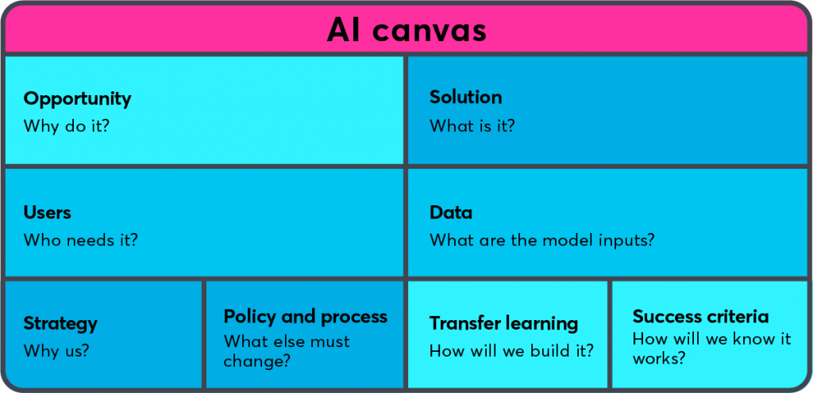
AI Canvas: provide high-level overview
To create an digital way of recognising the condition of a bannana
Training a CNN model to classify spoiled and healthy bannanas.
Consumers
Images from imsitu dataset and Google images
PoC
SKIP THIS PART
User testing
Economic disruption

Slide 4
Target audience analysis
Demographics:
All ages up to 30, all genders, all education levels and all incomes can use this application.
Psychographics:
People who are concerned about their health or the waste of food are more likely to use this application
Behavioural:
People who eat bannanas frequently may be more likely to use this application. People who have had negative experiences wth a spoiled bannna would be more motivated to use this application. People who are comfortable using an application/technology to buy things may be more likely to use this application
→ health-conscious people of all ages up to 30, with an interest in food safety, nutrition, and environmental responsibility, who consume bananas frequently and are willing to use technology to make informed purchasing decisions.
Notes:
Age: consumers of all ages up until 30 are most likely to use the app as they are most likely to use an app while shopping.
Gender: this application is relevant to all genders.
Education: consumers with any level of education could benefit from this application.
Income: the application could be useful for consumers of all income levels, as bananas are a widely consumed fruit that is relatively affordable
Interests: health, food safety, and nutrition.
Personality traits: health-conscious, detail-oriented, and concerned about food waste.
Values: health, safety, and environmental responsibility.
Based on this analysis, the target audience for the consumers of this application would be health-conscious individuals of all ages, with an interest in food safety, nutrition, and environmental responsibility, who consume bananas frequently and are willing to use technology to make informed purchasing decisions.
Frequency of banana consumption: consumers who frequently consume bananas may be more likely to use this application.
Prior experience with spoiled bananas: consumers who have had negative experiences with spoiled bananas may be more motivated to use this application.
Willingness to use technology: consumers who are comfortable using mobile applications and technology to make purchasing decisions may be more likely to use this application.

Slide 5
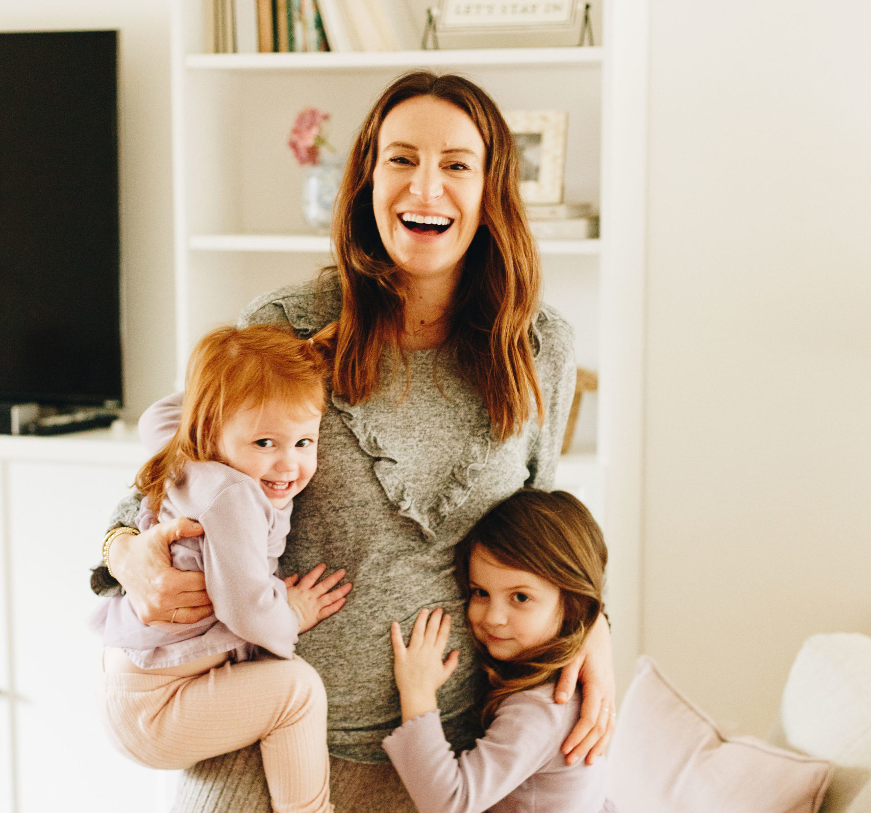
User persona
Name: Ella Lopez
Personal background
Age: 28
Status: Stay-at-home Mother
Education: High School diploma
User invironment
Location: home
Devices: smartphone
Psychographics
Wants to make sure the family eats healthy. Does not want to waste money and throw away food. Does not have much time, so when shopping for groceries Ella does not always have time to check if the food is in good condition.
Scenario
Ella goes to the supermarket and buys healthy food for her family. A few days goes by and she wants to give her kids bannanas to eat for snack. But she doesn’t know if the bannas are in good condition. Ella uses the bannanalyzer app.
End Goal
The primary goal of the application is to help consumers make informed decisions about the bananas they purchase and consume, with the aim of reducing food waste and promoting food safety. By quickly identifying spoiled bananas, consumers can avoid purchasing and consuming them, which can reduce the likelihood of foodborne illness and improve overall health. Additionally, the application could help reduce food waste by allowing consumers to identify spoiled bananas before they go bad and need to be discarded.

Slide 6
My Idea for application
Bannana classificer app: Bannanalyzer
The idea for the application is to develop a machine learning model that can accurately classify whether a banana is spoiled or not based on a photo.
The main goal of the application is to help consumers make informed decision about the bannanas they are buying, by doing this you can reduce food waste. This promotes eating healthy and food safety.
Notes:
The idea for the application is to develop a machine learning model that can accurately classify whether a banana is spoiled or not based on its image. The application would allow users to take a picture of a banana with their mobile phone camera and receive a prompt response indicating whether the banana is safe to eat or not. The application would use a convolutional neural network (CNN) trained on a dataset of images of spoiled and unspoiled bananas to make the classification.
The primary goal of the application is to help consumers make informed decisions about the bananas they purchase and consume, with the aim of reducing food waste and promoting food safety. By quickly identifying spoiled bananas, consumers can avoid purchasing and consuming them, which can reduce the likelihood of foodborne illness and improve overall health. Additionally, the application could help reduce food waste by allowing consumers to identify spoiled bananas before they go bad and need to be discarded.

Slide 7
Responsible AI (Fairness & Bias)
Bias, fairness, transparency and interpretability
Bias in the imsitu dataset → Representation Bias:
When we look at praying there are more images of people praying with both hands put together than not. Out of the 19 pictures that show up when searching for the verb praying, only 2 are pictures of hands not put together.
This negatively affects the different religions. Most of the pictures are Christian people praying, but this disproportionately affects other religions such as Hinduism, Islam, Judaism, Buddhism, etc.

Slide 8
Proof-of-Concept: Deep Learning
Present the final model you developed on the use-case you selected.
The dataset
Baselines
Preprocessing
CNN architecture
CNN training
Model performance
Error analysis
Iteration
ILO Mapping: The PoC slides relate to ILO 4.1 Sufficient & Good criteria

Slide 9
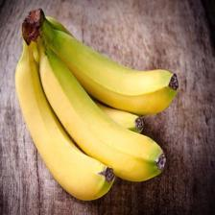
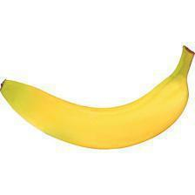
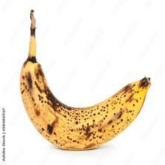
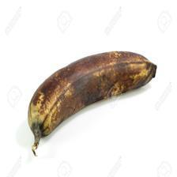
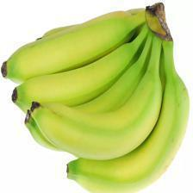
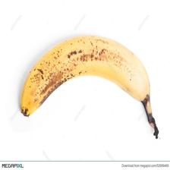
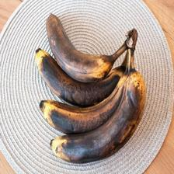
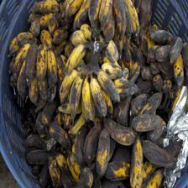
PoC: The dataset
I have a Binary classification, so my model chooses form 2 classes:
Not spoiled bannana(1) Spoiled bannana (0)

Slide 10
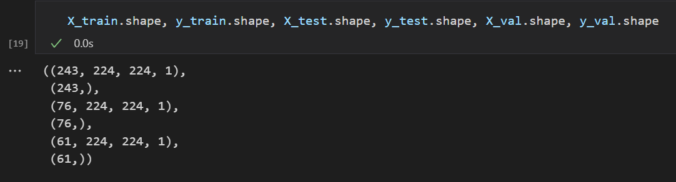
PoC: The dataset
In the Not spoiled bannans, I have 213 images
In the Spoiled bannans, I have 167 images
My images all have a size of (224,224)
Data scource: Imsitu dataset, Google images (using google image scrapper)

Slide 11
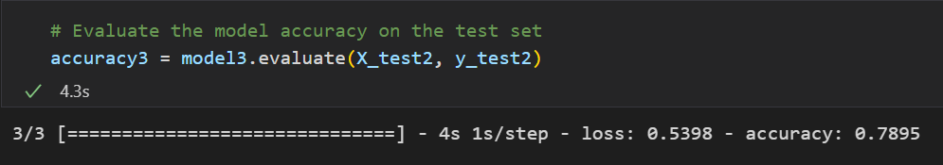
PoC: Baselines
Random guess accuracy? 50%
Human-Level Performance? 74.6%
Multilayer Perceptron? 78.9%
Notes:
Random guess accuracy:The random geus accuracy is 50% because is is a binary classification model ((1/2 = 0.5)*100% = 50%)
Human-Level Performance accuracy: 74.6%. This is expected that people will get high accuracies, but what let them down was that they thought the unripe bannanas were also spoiled.
Multilayer Perceptron accuracy: 78.9%. My model got an accuracy of 78.9% after data augmentation and collecting more data.

Slide 12
PoC: Preprocessing
First resized the image to a fixed size of 224x224, which is a common input size for many image recognition models.
Next, I converted the image to a float between 0 and 1 by dividing each pixel value by 255.
Finally I normalized the pixel values by subtracting the mean RGB values

Slide 13
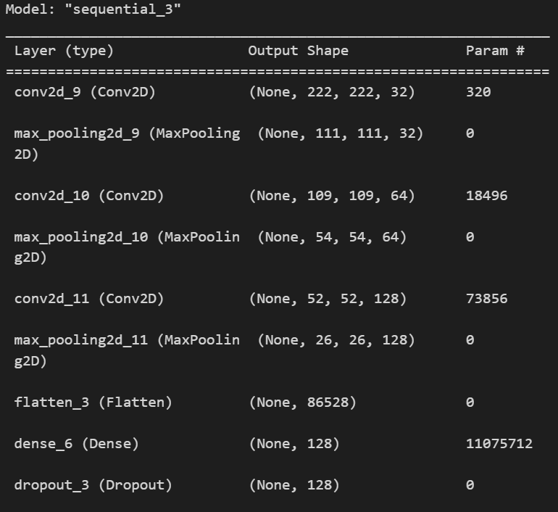
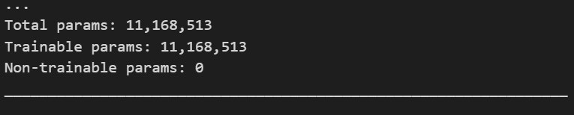
PoC: CNN architecture
Show every layer using model.summary()

Slide 14
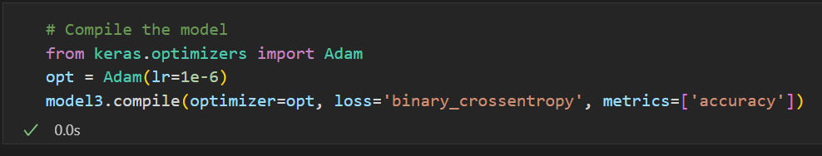
PoC: CNN training
Binary classification so I chose
Loss function: Binary crossentropy
I used the precision metric, recall metric and F1 metric because they were part of the classification report.
Notes:
Binary crossentropy: This is a common loss function used for binary classification problems. It measures the difference between the predicted probability distribution and the actual probability distribution. It is calculated as the negative logarithm of the predicted probability for the true class.Which optimizer and learning rate is used and why?
Plot & interpret learning curves

Slide 15
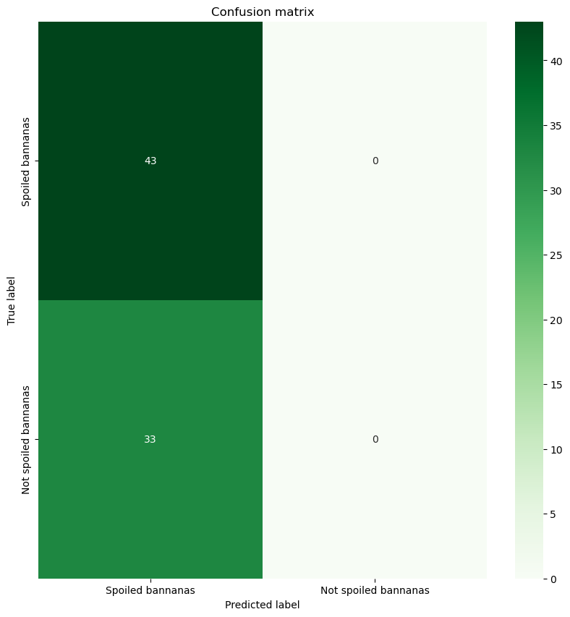
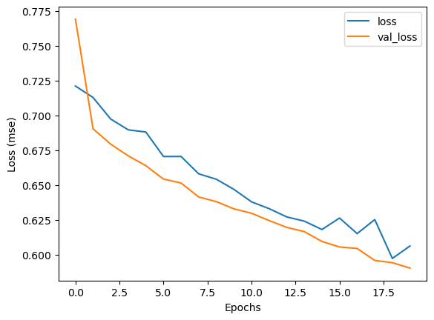
PoC: Model performance
Show & interpret selected metrics and/or plots.

Slide 16
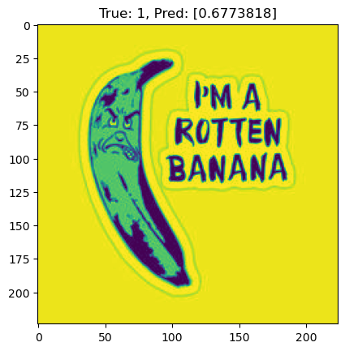
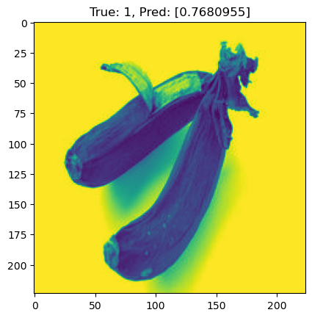
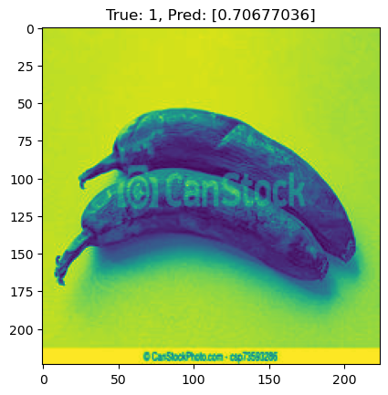
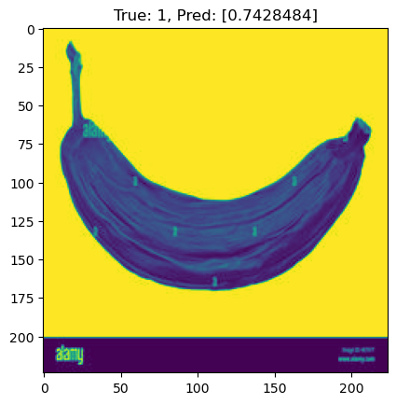
PoC: Error analysis

Slide 17
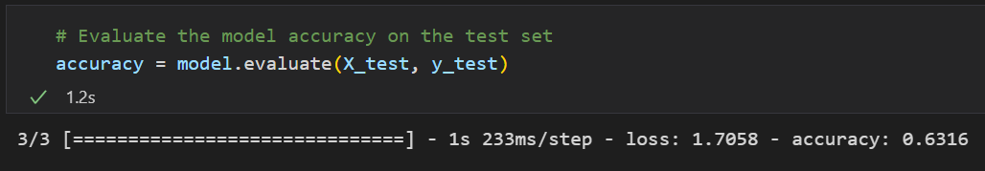
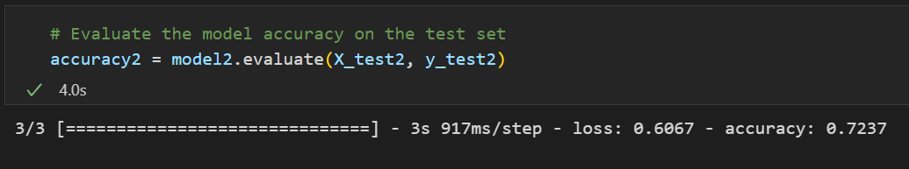
PoC: Iteration
Original accuracy
I tackled working with small datasets by collecting more images and I used data augmentation. By doing this I increased the accuracy of my model.
After collecting more data
After Data augmentation
Notes:
You have described your finalized model. Explain how you got here from the very first model you created. Describe a minimum of two iterations you did.
On week 4, day 4, you learned 3 methods to tackle small datasets. Explain which one did you use and how it changed your model performance
On week 5 you learned about error analysis and data iteration loop. Explain what you observed in the error analysis and how did you change the dataset as a result.
And any other iteration you would like to describe.

Slide 18
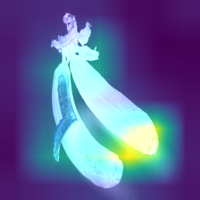
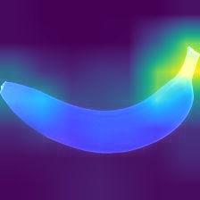
Responsible AI (Transparency & Interpretability)
Bias, fairness, transparency and interpretability
In this application the accuracy is more import than the interpretability of the model as the user just needs to know if the banana is spoiled or not spoiled. They don’t need to know why it is classed in such a way.
I have shown interpretability in my AI model by using Grad-cam.
Notes:
ILO Mapping:
(Partially) ‘Sufficient’, and ‘Good’ criteria of ILO 3.1.
Requirements:
Discuss the trade-off between accuracy and interpretability of your AI model (applied to the Creative Brief)
Develop an AI model that balances accuracy and interpretability (applied to the Creative Brief)

Slide 19
Disruptive Technology Risks
Risks
Contingency Plan
Economic disruption: If the application proves to be highly effective at detecting banana spoilage, it could lead to economic disruption in the banana industry. For example, it could lead to a decrease in the demand for visually inspecting bananas and result in job losses for workers in the industry.
Dependence on technology: To address the risk of dependence on the technology, the contingency plan might include developing alternative methods for detecting banana spoilage, such as combining the machine learning model with other forms of visual inspection or implementing manual inspection processes as a backup. It could also involve maintaining redundant systems or creating partnerships with other companies or organizations to ensure a stable supply chain in the event of a technology failure.

Slide 20
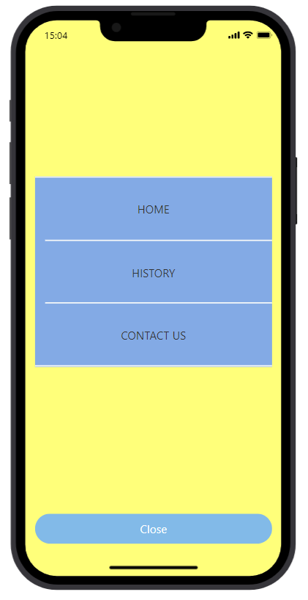
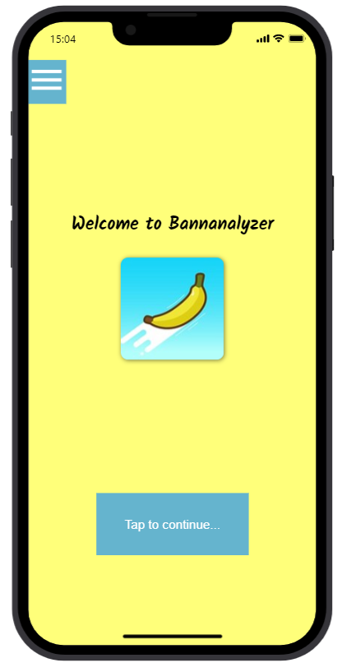
HCAI - Application Design:
High-level concept design:
The people using the app are probably comfortable with technology influencing their purchasing decisions and want to be healthy.So when they use the app, they may not have much time to get the result before buying the banana.
So the app must have a smooth Menu flow and calm coloring.
ILO Mapping: Poor & Excellent

Slide 21
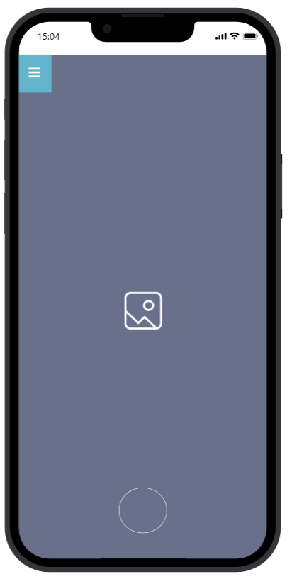
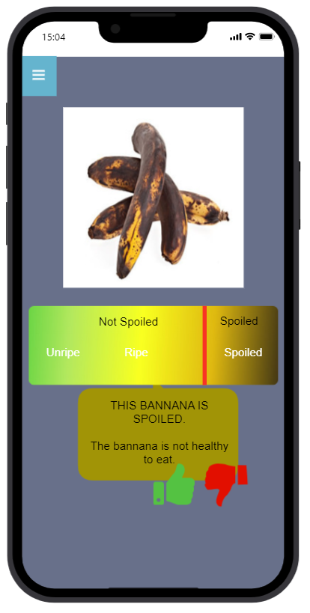
HCAI - Application Design
Algorithm Embedding:
The computer vision algorithm is embedded by getting the image from the camera roll and it gives out a classification.
The algorithm will detect if the banana is spoiled or not by looking how dark the banana is or how many dark spots the banana has.
ILO Mapping: Poor & Sufficient
Notes:
How is the computer vision algorithm embedded?
What will the eventual algorithm detect and how?
Will the algorithm be able to do more then demonstrated in the proof-of-concept?

Slide 22
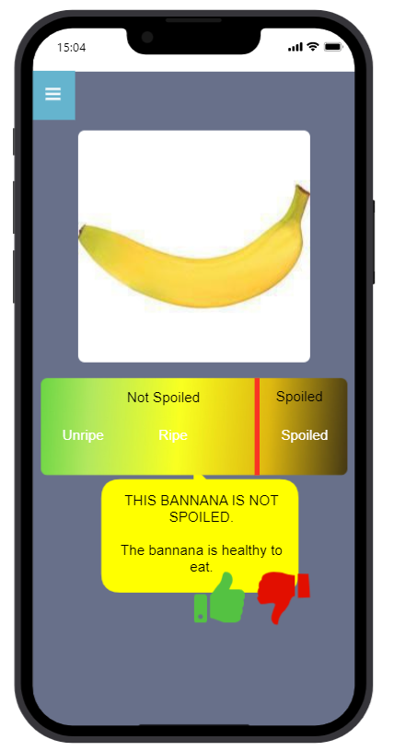
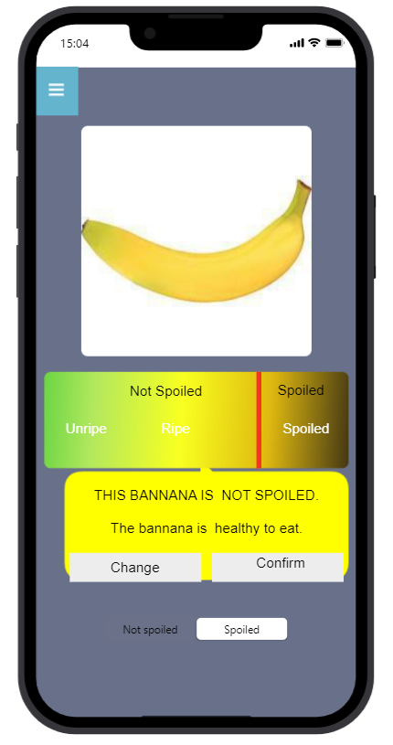
HCAI - Application Design:
Continuous Learning
The model allows for continuous learning by letting the users to give feedback on the classification. This way the users can change the class of some images which allows a continual supervised learning .
ILO Mapping: Poor & Sufficient

Slide 23
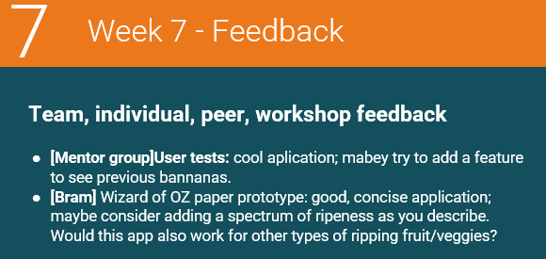
HCAI - Application Design:
Feedback
ILO Mapping: Insufficient, Sufficient & Good

Slide 24
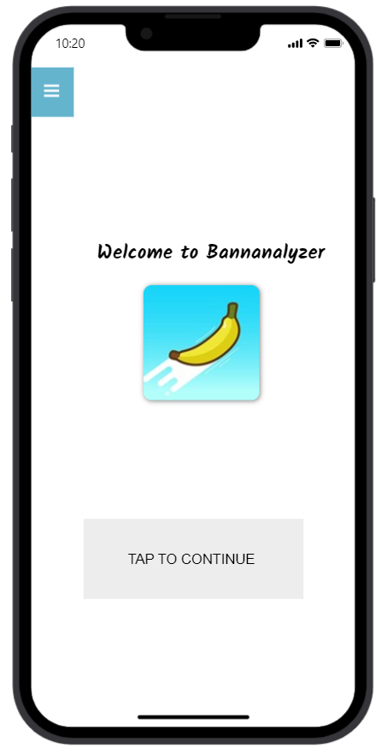
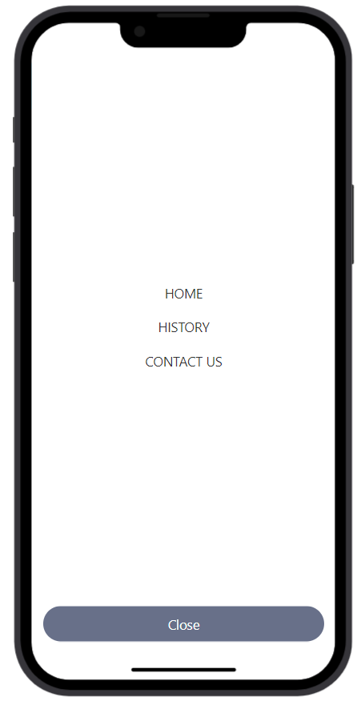
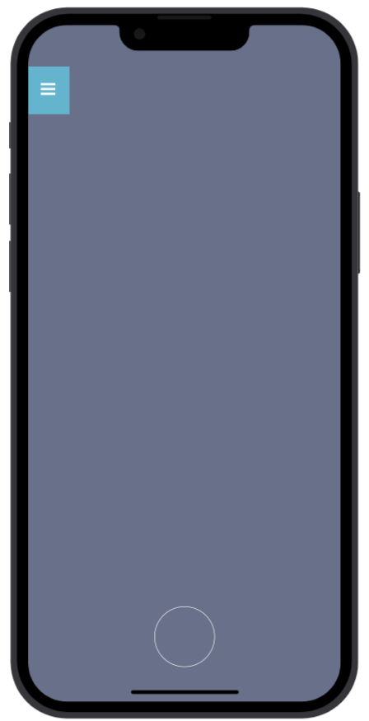
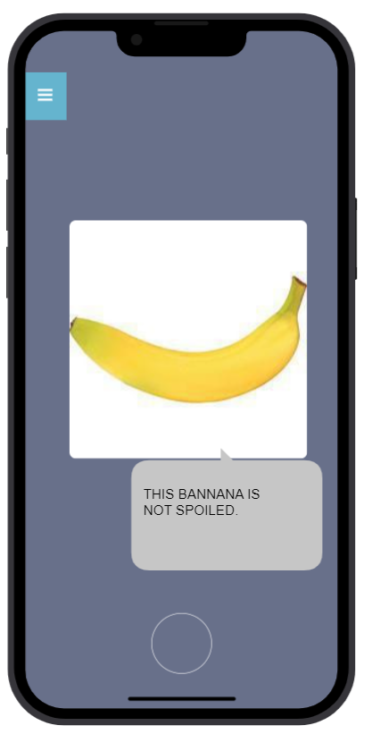
HCAI - Application Design:
Low-level design:
ILO Mapping: Excellent

Slide 25
HCAI - Application Design:
Wireframe Prototype:
Demo:
HCAI_Prototype_[Bannanalyzer]_[Neil]-html.zip
ILO Mapping: Poor, Sufficient, Good & Excellent

Slide 26
Thank you!
Any questions?

